Slide 1
High Fidelity Prototyping
Dr Kristin Stock

Slide 2
What is a prototype?
In interaction design it can be (among other things):
a series of screen sketches
a storyboard, i.e. a cartoon-like series of scenes
a Powerpoint slide show
a video simulating the use of a system
a lump of wood (e.g. PalmPilot)
a cardboard mock-up
a piece of software with limited functionality written in the target language or in another language

Slide 3
Why prototype?
Evaluation and feedback are central to interaction design
Stakeholders can see, hold, interact with a prototype more easily than a document or a drawing
Team members can communicate effectively
You can test out ideas for yourself
It encourages reflection: very important aspect of design
Prototypes answer questions, and support designers in choosing between alternatives

Slide 4
What to prototype?
Technical issues
Work flow, task design
Screen layouts and information display
Difficult, controversial, critical areas

Slide 5
High-fidelity prototyping
Uses materials that you would expect to be in the final product.
Prototype looks more like the final system than a low-fidelity version.
For a high-fidelity software prototype common environments include Macromedia Director, Visual Basic, and Smalltalk.
Danger that users think they have a full system…….see compromises

Slide 6
But…
Can be costly, especially if they don’t end up being used for the final design.
Reviewers and testers tend to comment on superficial aspects rather than the content.
Can mean developers become too invested and don’t want to change the design.

Slide 7
Compromises in prototyping
All prototypes involve compromises
For software-based prototyping maybe there is a slow response? sketchy icons? limited functionality?
Two common types of compromise
‘horizontal’: provide a wide range of functions, but with little detail
‘vertical’: provide a lot of detail for only a few functions
Compromises in prototypes mustn’t be ignored. Product needs engineering

Slide 8
Prototyping as Filter
Can use prototypes to filter/emphasise particular aspects of the design that you want to explore.
Do you especially want to get information about:
Layout
Functionality
Data aspects…

Slide 9
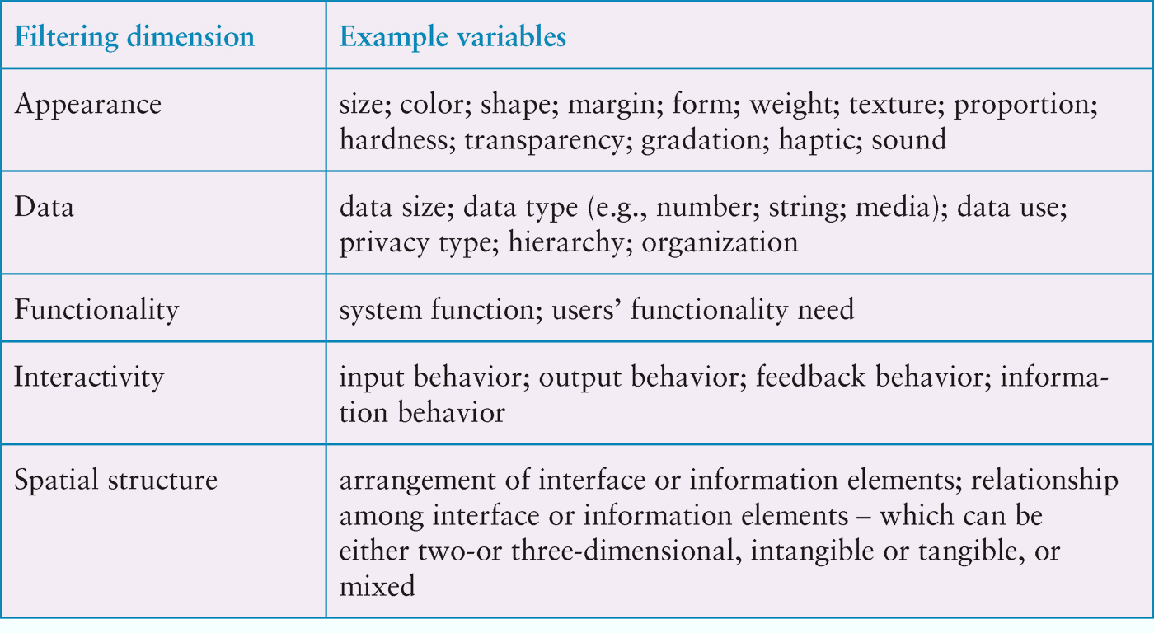
Filtering dimensions of prototyping

Slide 10
Prototyping as Manifestation
Can use prototypes to manifest a particular design idea – as a tool to help explore and develop an idea.

Slide 11
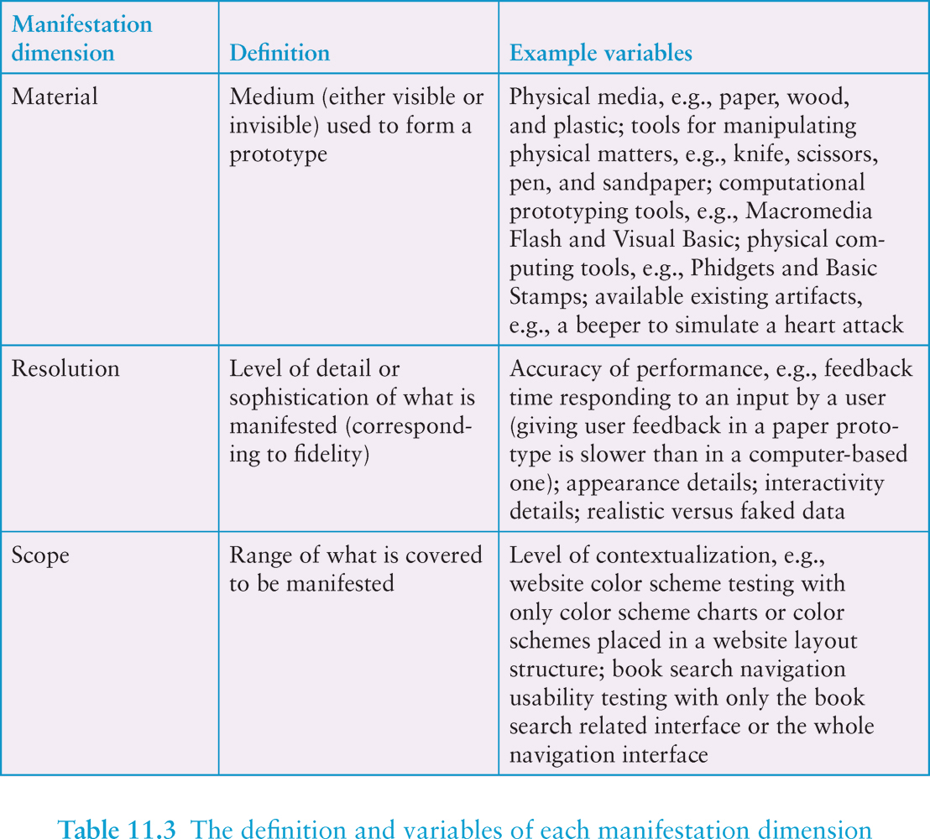
Manifestation dimensions of prototyping

Slide 12
Economic Principle of Prototyping
no more than necessary
“The best prototype is one that, in the simplest and most efficient way, makes the possibilities and limitations of a design idea visible and measurable.”
(p.397, Rogers, Sharp and Preece, 2011).
enough for evaluation

Slide 13
Construction
Taking the prototypes (or learning from them) and creating a whole
Quality must be attended to: usability (of course), reliability, robustness, maintainability, integrity, portability, efficiency, etc
Product must be engineered
Evolutionary prototyping
‘Throw-away’ prototyping

Slide 14
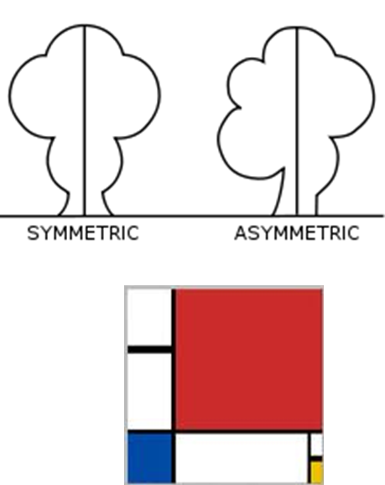
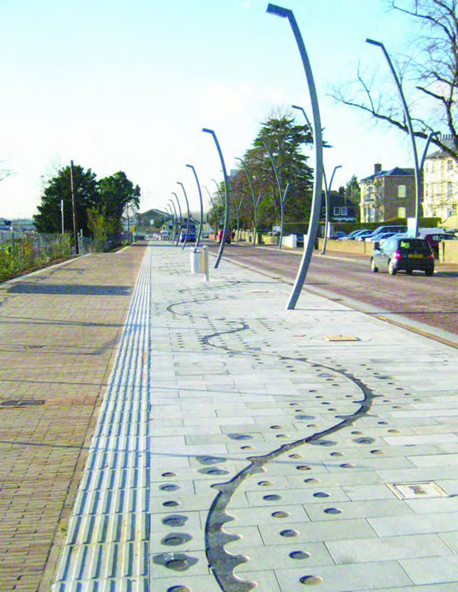
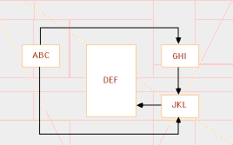
Some Design Principals
Balance
Emphasis
Unity

Slide 15
Areas of design
Lines and Borders
Colour
Images
Text
Form Elements
Navigation

Slide 16
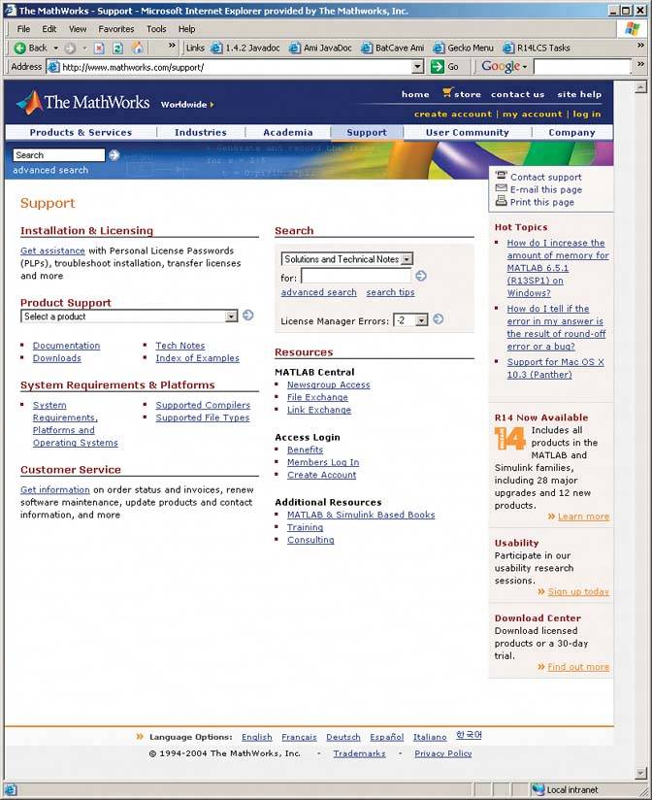
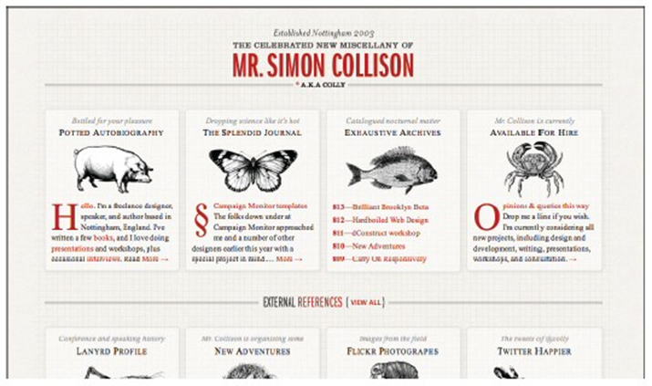
Areas of design: Lines and Borders
Create physical grouping
Borders offer possibilities for creative styling

Slide 17
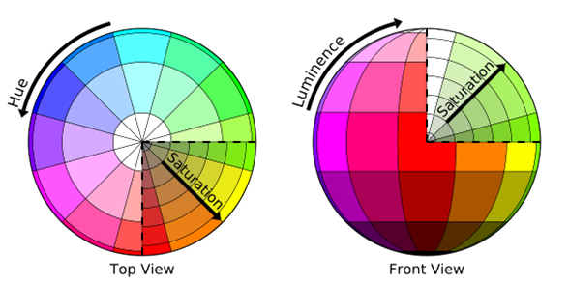
Areas of design: Colour
Schemes
Monochromatic (single hue)
Monochromatic + white
Analogous (adjacent on colour wheel)
Complimentary (opposite on colour wheel)
Colour discord
Contrast
Colour blindness?

Slide 18
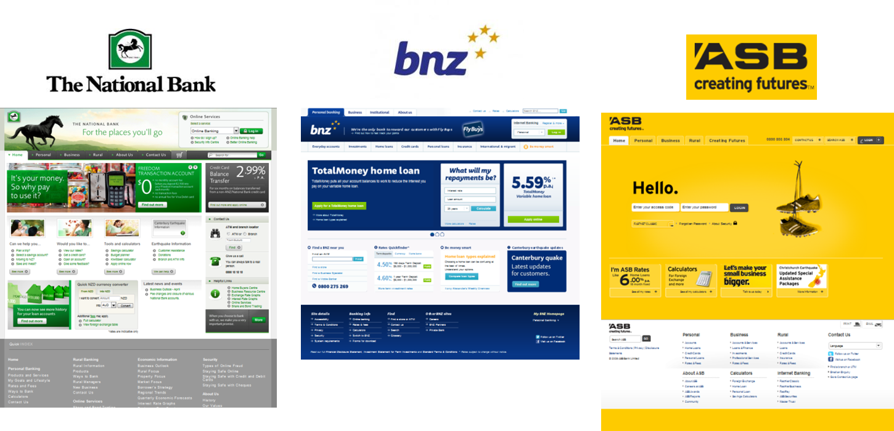
Areas of design: Images
How does it support your design?
Relevance
Cost (image size)
Colours
Branding
Logos

Slide 19
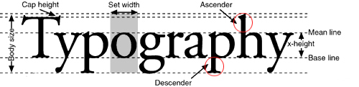
Areas of design: Text
Purpose of text
Commentary text is text that informs
Instrumental text is text that works; e.g. hyperlinks, button, labels (this will be covered in the lecture on forms & controls)
Legibility
Readability
Physical Factors

Slide 20
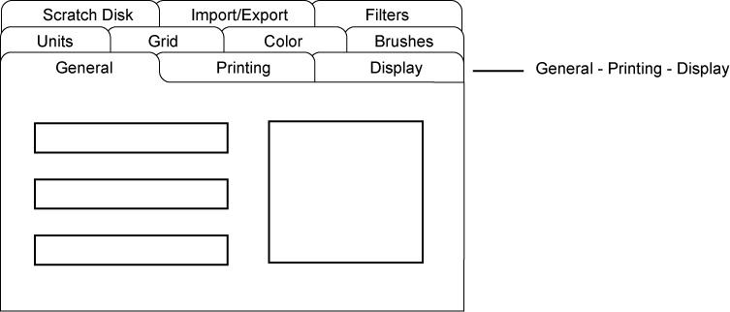
Areas of design: Form Elements
Grouping
Panels, frames and tabs
Controls
Buttons (icons vs. text)
Hyperlinks
Text fields
Selections (lists/radio buttons/checkboxes)
Pickers (colour/date/time)
Interfaces that look good are perceived as working better

Slide 21
Areas of design: Navigation
Left navigation
Breadcrumbs
Menus
In place
Tabs
Dropdown menus
Footers

Slide 22
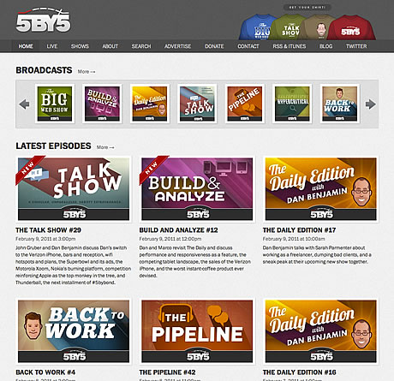
Grid-based Layouts
All elements lined against a grid
12-column grid
960 Grid System
Benefits
Clarity/order
Efficiency
Economy
Consistency/harmony

Slide 23
Anatomy of a Web Page
Logo
Branding elements
Search and login
functionality
Left
navigation
Content Header
Associated
content
(ads?)
Footer

Slide 24
Some Web Page Structures
Floating panel
Letterbox
Bento box

Slide 25
Web Design Conventions
Help the user to understand your page
Logo
Top-left, link to home page
Search
Top-right, minimal (utility function)
Footer
Less “critical stuff”, navigation (for when the user really wants it)
Buttons
Should look like buttons (clickable!)

Slide 26
Responsive Design
Interface adapts to user’s device
Desktop system
Tablet device
Smart phone
Smart watch
Same/different design?
Same/different elements?
What is important?

Slide 27
Tools for High Fidelity Prototyping
There are many.
Examples:
For web pages, MS Frontpage, Adobe Dreamweaver
Visual Studio lets you create Windows style prototypes, with Blend, Sketchflow, etc.
etc.

Slide 28
Visual Studio
Integrated Development Environment (IDE)
Code editor, debugger.
Multiple languages: VB, C++, C#, etc.
Design tools to help generate code.

Slide 29
Design Tools in Visual Studio
Windows Forms Designer, for desktop apps.
Tools for creating web sites (HTML/CSS, ASP.NET).
XAML Interfaces:
XAML Designer.
Blend – advanced design tasks like animations and behaviours.
Both for creating XAML applications for desktop, web, phone.
Sketchflow (not in VS 2015).

Slide 30
Design Tools in Visual Studio (contd.)
Visual Studio (and Blend) both provide visual tools for building engaging user interfaces and rich media experiences for XAML-based Windows desktop, web, Windows Phone, and Windows Store apps.
Windows Presentation Foundation (WPF) is a UI framework that creates desktop client applications. The WPF development platform supports a broad set of application development features, including an application model, resources, controls, graphics, layout, data binding, documents, and security.

Slide 31
XAML
Extensible Application Markup Language
Microsoft XML-based markup language.
Used as a user interface markup language to define UI elements (such as controls, text, images, etc.), eventing, etc.
XAML is declarative and requires the addition of code if you need to add run-time logic to your application.
If your application uses only XAML, you can create and animate UI elements, and configure them to respond in a limited way to user input (by using event triggers)
You need to add to your application to perform and respond to calculations or spontaneously create new UI elements.
The code for a XAML application is stored in a separate file from the XAML document.

Slide 32
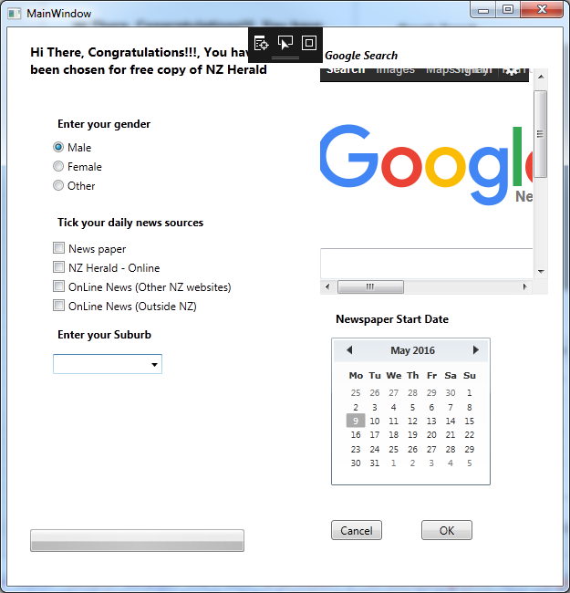
UI of Wpf Application (VS 2015 – XAML)

Slide 33
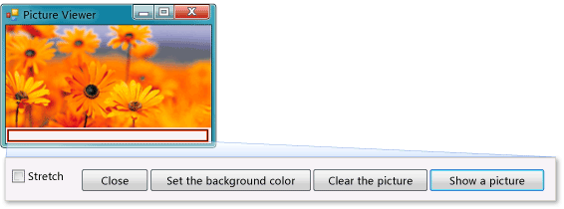
Tutorial create a simple form in Visual Studio 2015
https://msdn.microsoft.com/en-us/library/dd492135.aspx

Slide 34
Visual Studio 2015 Web Designer
https://docs.asp.net/en/latest/tutorials/your-first-aspnet-application.html

Slide 35
Visual Studio 2015 XAML Designer Resources
https://msdn.microsoft.com/en-us/library/hh921077.aspx
https://msdn.microsoft.com/en-us/library/hh921077.aspx
https://mva.microsoft.com/en-US/training-courses/developing-universal-windows-apps-with-c-and-xaml-8363 (Microsoft virtual academy)

Slide 36
Tutorial for Blend for Visual Studio 2015
https://msdn.microsoft.com/en-us/library/jj171012.aspx

Slide 37
You can try this at home…
Visual Studio Community 2015
Download and use for free for non-commercial purposes.
Lots of resources on the web.
You can also use any other tool of your choice.

